Slide 1


Spotify Music Data Analysis
Prathamesh Thite

Slide 2
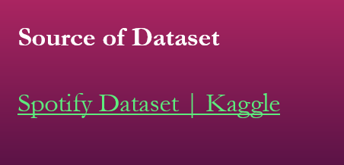
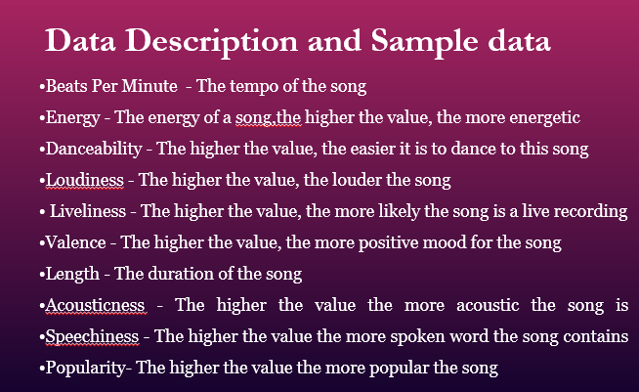
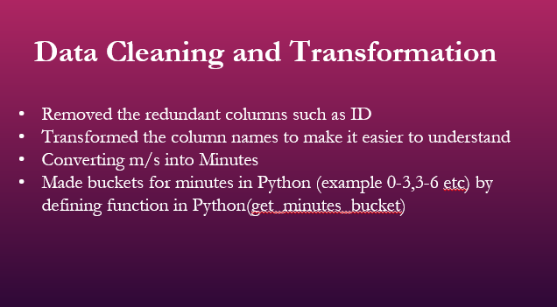
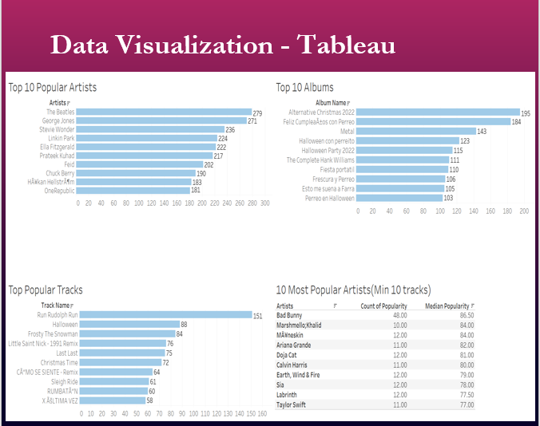
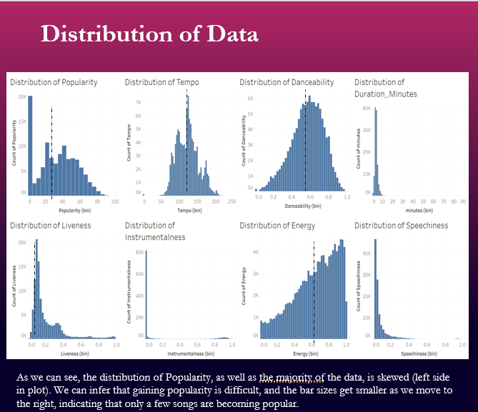
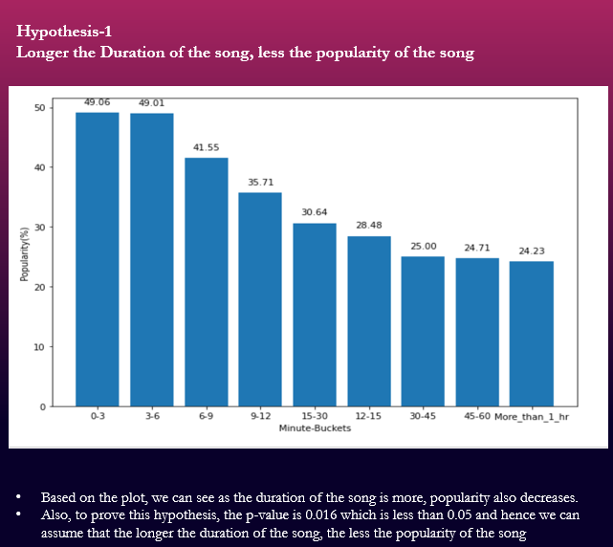
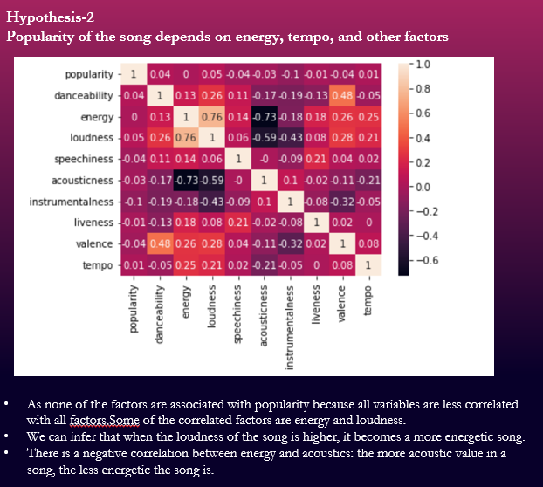
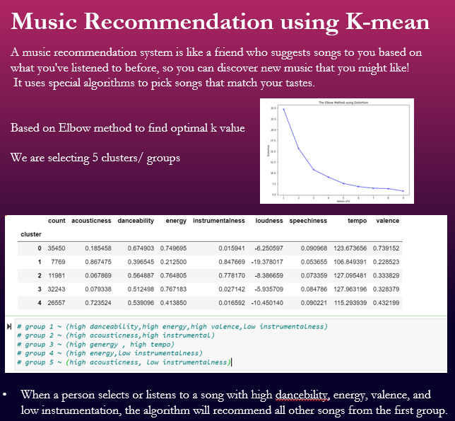
Slides summary
Source of Data
Data Description and Sample data
Data Cleaning and Transformation
Data Visualization – Tableau
Distribution of Data
Hypothesis- 1
Hypothesis -2
Music Recommendation

Slide 3
Source of Dataset
Spotify Dataset | Kaggle

Slide 4
Data Description and Sample data
•Beats Per Minute - The tempo of the song
•Energy - The energy of a song, the higher the value, the more energetic
•Danceability - The higher the value, the easier it is to dance to this song
•Loudiness - The higher the value, the louder the song
• Liveliness - The higher the value, the more likely the song is a live recording
•Valence - The higher the value, the more positive mood for the song
•Length - The duration of the song
•Acousticness - The higher the value the more acoustic the song is •Speechiness - The higher the value the more spoken word the song contains •Popularity- The higher the value the more popular the song

Slide 5
Data Cleaning and Transformation
Removed the redundant columns such as ID
Transformed the column names to make it easier to understand
Converting m/s into Minutes
Made buckets for minutes in Python (example 0-3,3-6 etc) by defining function in Python(get_minutes_bucket)

Slide 6
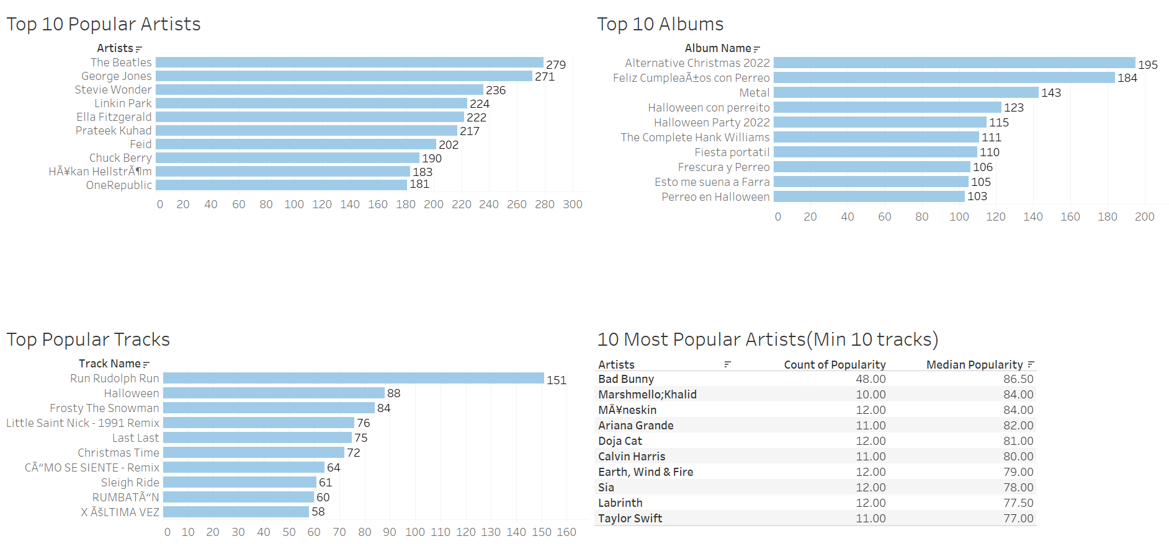
Data Visualization - Tableau

Slide 7
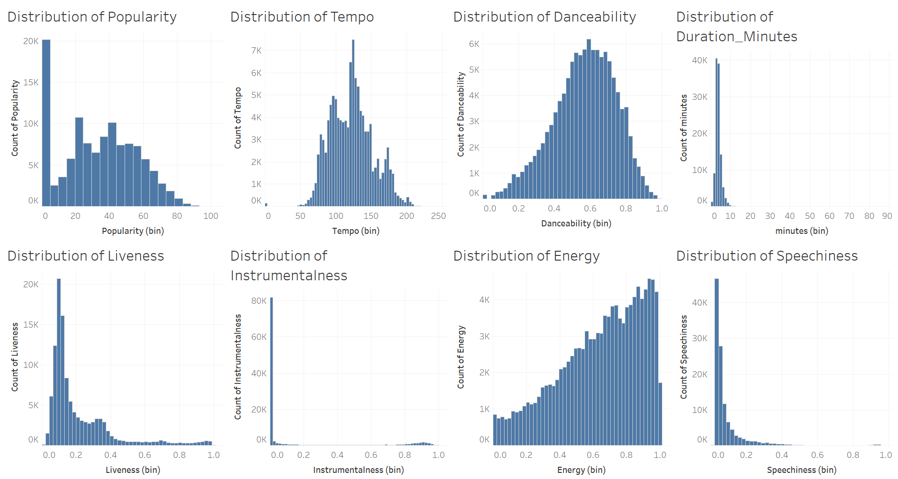
Distribution of Data
As we can see, the distribution of Popularity, data is right-skewed (left side in plot). We can infer that gaining popularity is difficult, and the bar sizes get smaller as we move to the right, indicating that only a few songs are becoming popular.

Slide 8
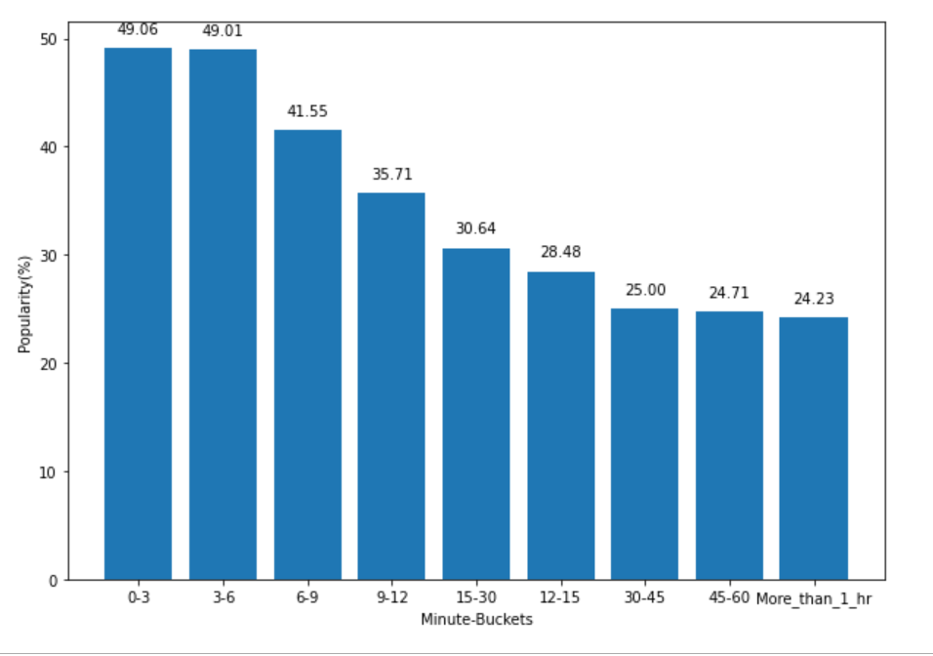
Hypothesis-1 Longer the Duration of the song, less the popularity of the song
Based on the plot, we can see as the duration of the song is more, popularity also decreases.
Also, to prove this hypothesis, the p-value is 0.016 which is less than 0.05 and hence we can assume that the longer the duration of the song, the less the popularity of the song

Slide 9
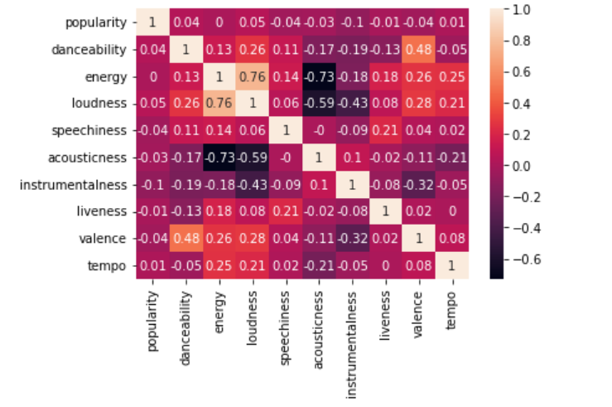
Hypothesis-2 Popularity of the song depends on energy, tempo, and other factors
As none of the factors are associated with popularity because all variables are less correlated with all factors.
Some of the correlated factors are energy and loudness.
We can infer that when the loudness of the song is higher, it becomes a more energetic song.
There is a negative correlation between energy and acoustics: the more acoustic value in a song, the less energetic the song is.

Slide 10
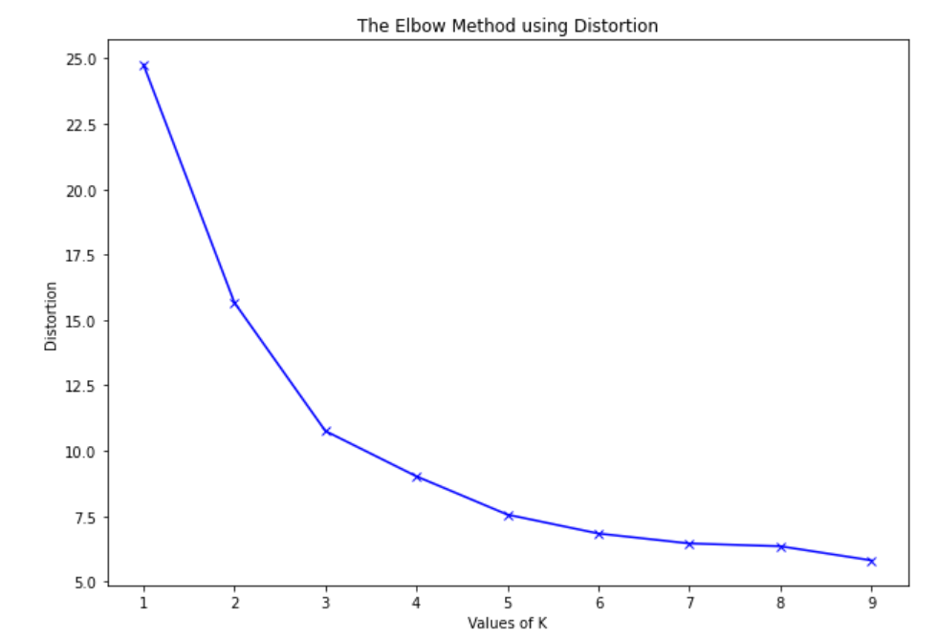
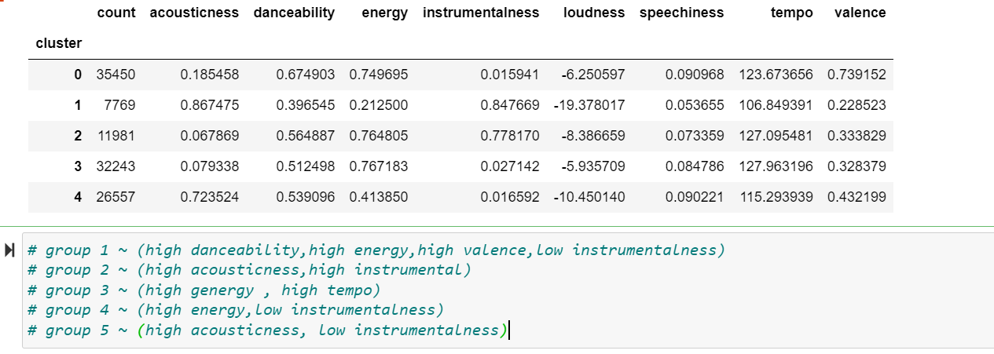
Music Recommendation using K-mean
A music recommendation system is like a friend who suggests songs to you based on what you've listened to before, so you can discover new music that you might like!
It uses special algorithms to pick songs that match your tastes.
Based on Elbow method to find optimal k value
We are selecting 5 clusters/ groups
When a person selects or listens to a song with high dancebility, energy, valence, and low instrumentation, the algorithm will recommend all other songs from the first group.

Slide 11
Thankyou
Wanda & Chelsea

